Slide 1
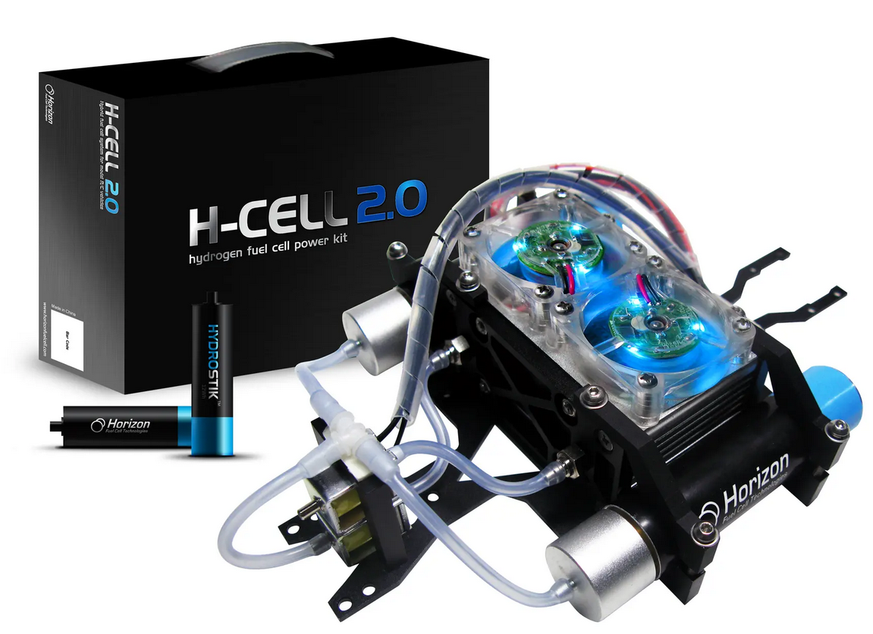
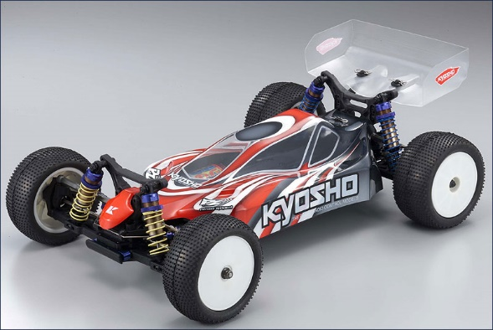
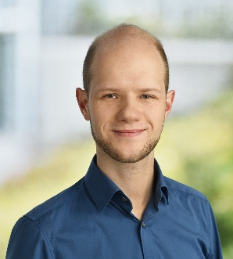
Characterisation of fuel cell battery hybrid propulsion system for a 1:10 RC car
Description
Polymer electrolyte membrane (PEM) fuel cell drives are currently experiencing a boom, especially for applications, where large amounts of energy have to be carried along; e.g. in the field of truck and aircraft drives - batteries of the current state of the art would entail too much weight for this application. But fuel cells are also interesting for small, autonomous systems that are to have a long operating duration. Hybridization with batteries makes it possible to achieve a compromise between range, weight and responsiveness. In this project work, an off-the-shelf fuel cell system from the company Horizon Educational is to be examined for its applicability to a 1:10 RC model car.
Research Focus
Basic literature research on PEM fuel cells and hybrid drives.
Conversion of a Kyosho LazerZX-5 model car with a fuel cell hybrid drive (Horizon H-Cell2.0).
Characterization of the hybrid system in terms of performance, range and behavior.
Requirements and conditions
Very good knowledge of English, both written and spoken: The thesis should be written and presented in English.
The project thesis will be executed in groups of 3-5 people (please register under “Groups” in Stud.Ip). Detailed information and an invitation to a preliminary meeting will then be communicated after the registration deadline.
Copyright: Horizon Educational
Copyright: Kyosho
Contact
Arne v. Schweinitz, M. Sc.
Research associate
Hermann-Blenk-Str. 42
Room: 110
Tel.: +49 (0) 531 / 391 – 66922
Mail: arne.schweinitz@tu-bs.de








