Slide 1
About TU Braunschweig
Title of presentation | Name of speaker | Date

Slide 2

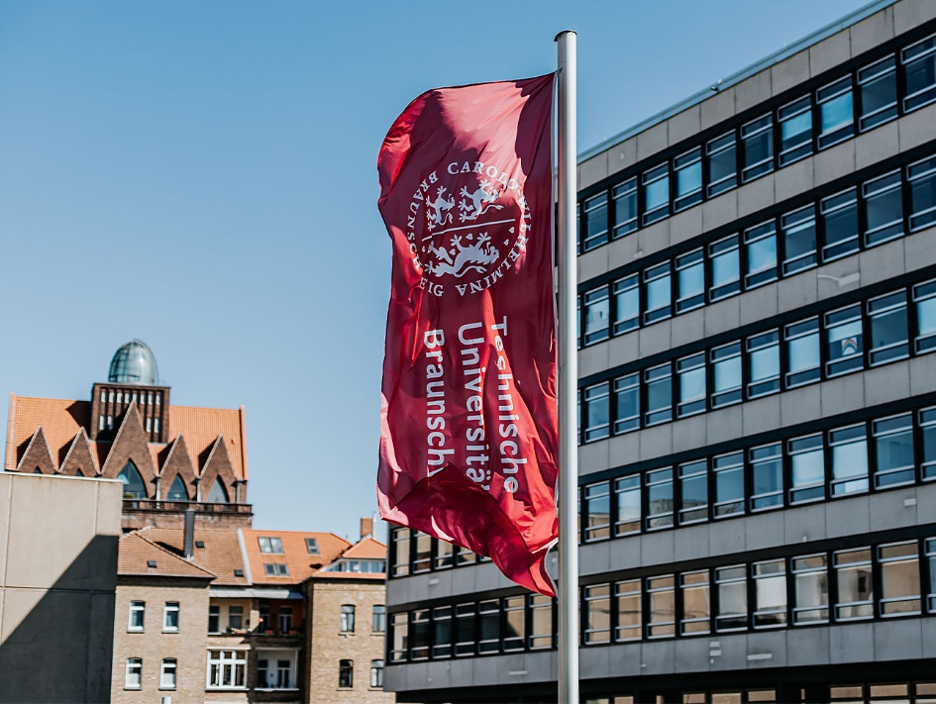



Key Figures 2025
founded in 1745
15,600 students | 3,300 of them international
3,800 staff members | 2,300 of them researchers 244 of them professors
€ 417m overall budget | € 132m third-party funding
4 core research areas
7 interdisciplinary research centres
6 faculties
2 clusters of excellence
86 degree programmes
2 DFG collaborative research centres

Slide 3
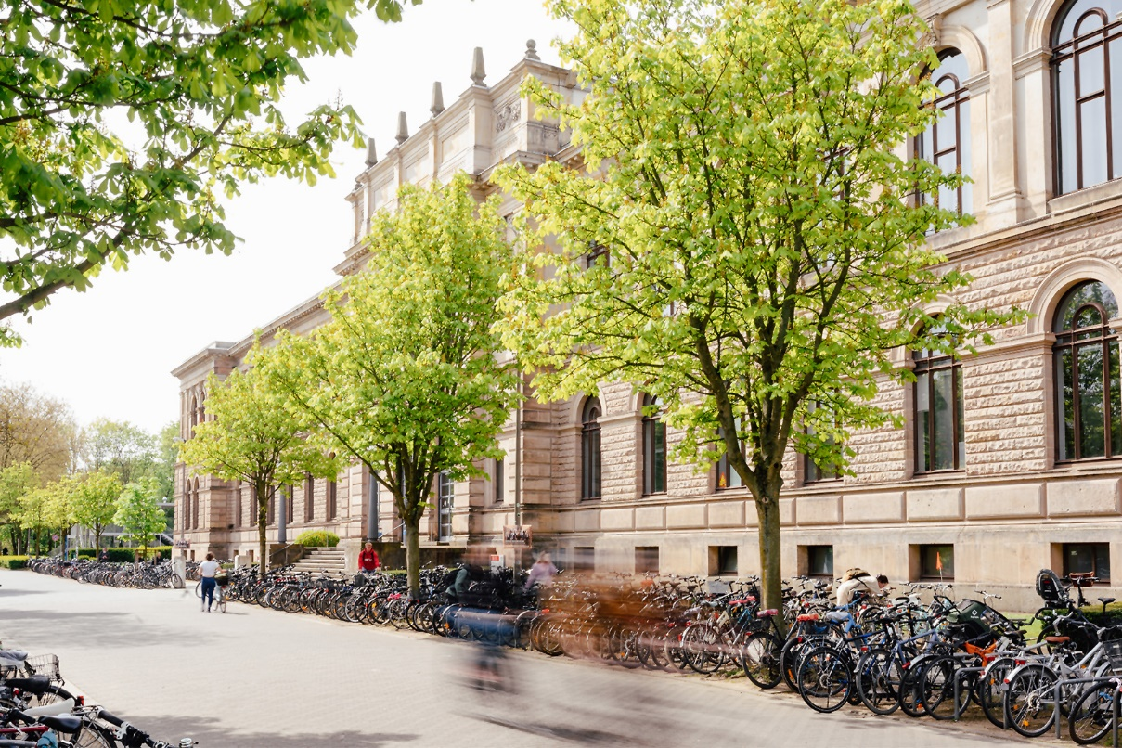
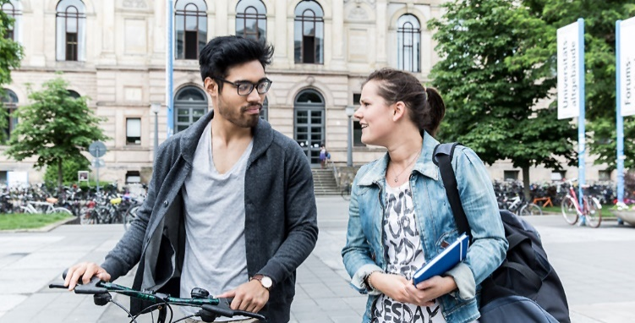
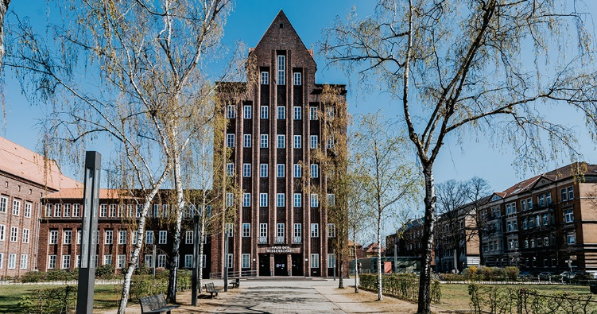
What TU Braunschweig Stands for
strong industrial and cooperation partner network in Europe’s most active research region
university of technology with the longest tradition in Germany
member of the TU9 Alliance, Germany’s leading 9 universities of technology
Notes:
3

Slide 4



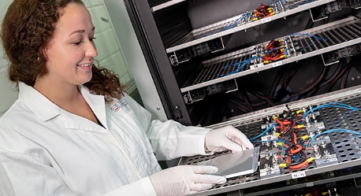

What TU Braunschweig Stands for
explicit STEM-focus: broad range of engineering programmes
complemented by natural sciences, social sciences and humanities
transdisciplinary education
strong basis research combined with a
high application orientation
Notes:
4

Slide 5


History
1745
Foundation of the Collegium Carolinum
1848
The Collegium Carolinum is renamed Herzogliche Technische Hochschule Carolo-Wilhelmina
1968
Establishment of a department for humanities and social sciences, the University gets its present name Technische Universität Braunschweig
1995
TU Braunschweig celebrates its 250th anniversary
2007
Braunschweig becomes German »City of Science«
2007–
2020
Foundation of 7 interdisciplinary research centres
(NFF, NFL, BRICS, LENA, PVZ, OHLF, ZeBra)
2018
Success in the excellence strategy:
clusters of excellence in aviation and metrology
Our history dates back to 1745, making us Germany’s university of technology with the longest tradition.
Notes:
5

Slide 6







Comprehensive University with 6 Faculties
Carl Friedrich Gauß Faculty (Mathematics, Computer Science, Business Science, Social Sciences)
Faculty of Life Sciences
Faculty of Architecture, Civil Engineering and Environmental Sciences
Faculty of Mechanical Engineering
Faculty of Electrical Engineering,
Information Technology, Physics
Faculty of Humanities and Education
Notes:
6

Slide 7
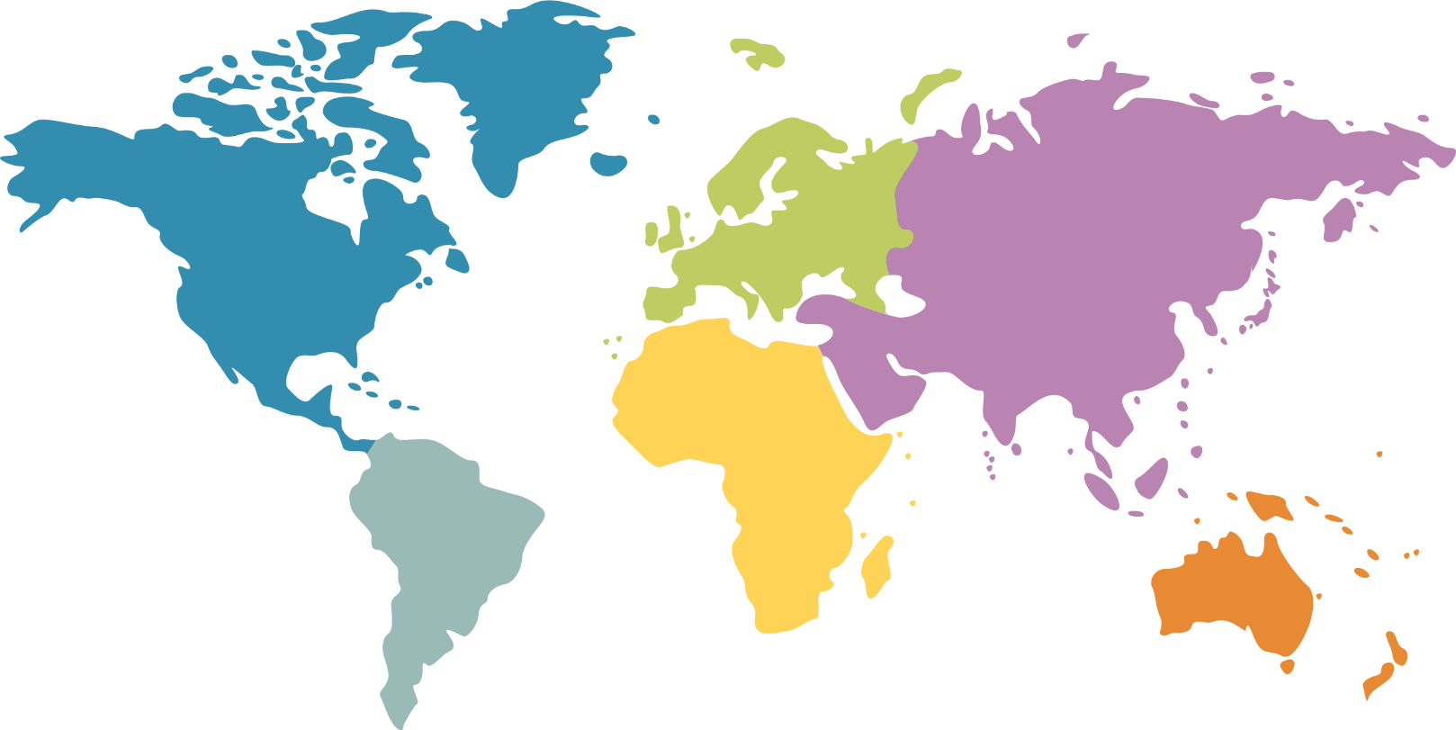


TU Braunschweig International
3,300
international students
110
countries
21 %
of all students
310
partner universities
2,121
(987 from China)
60
170
Erasmus agreements
610
Strategic partners: University of Strathclyde, Tampere University, University of Rhode Island, National Autonomous University of Mexico
345
Campus: Wolfsburg, Singapore
77
2
Key exchange partners:
USA, Canada, South America, India, China, Japan, Singapore
Notes:
7

Slide 8
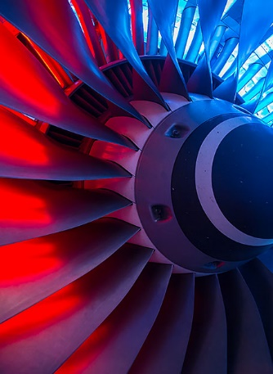
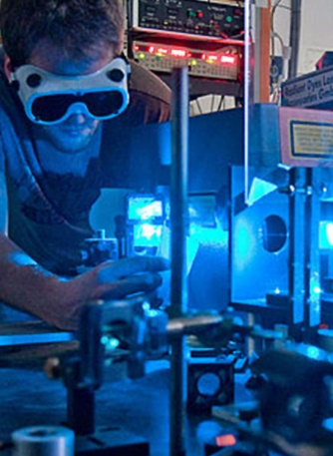
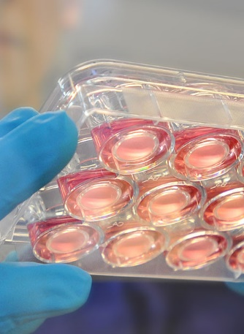
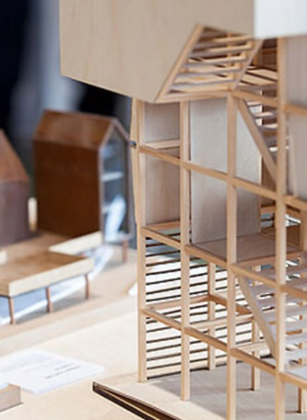
Research at TU Braunschweig: Core Research Areas
  TU Braunschweig has identified 4 interdisciplinary core research areas:
Mobility
Metrology
Engineering
for Health
Future City

Slide 9
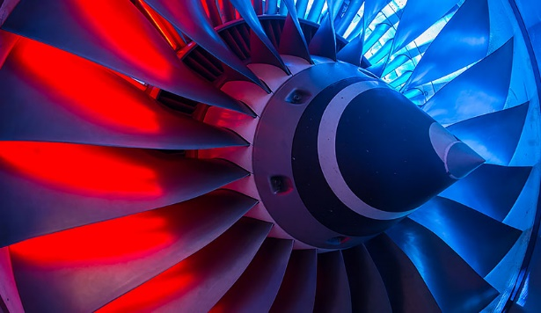
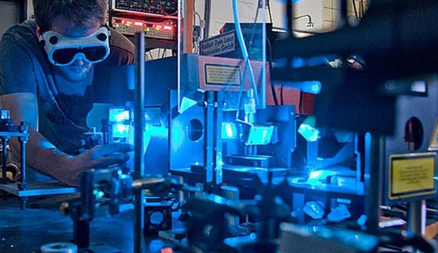
Research at TU Braunschweig: Clusters of Excellence
  TU Braunschweig has 2 Clusters of Excellence within the German University of Excellence scheme:
SE²A – Sustainable and Energy Efficient Aviation
established 2018
Quantum Frontiers
(together with LU Hannover)
established 2018
Core research area Mobility
Core research area Metrology

Slide 10







Research at TU Braunschweig: Research Centres
Our interdisciplinary research centres are long-term interdisciplinary
and interdepartmental research associations.
Professors from at least two faculties come together to form a
Research Centre.
In most cases, non-university research institutions are involved.

Slide 11
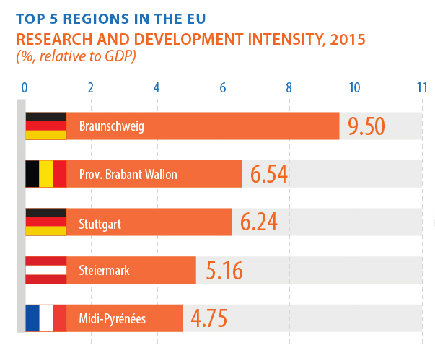
Situated in Europe’s Most Active Research Region
In the city and region of Braunschweig, more than 19,600 people work in research and development institutions.
4 % of the population work in research and development – this is the highest ratio in Europe.
More than 30 major research institutions and companies contribute to the research region.
According to Eurostat, Braunschweig has the highest ratio of GDP spent for research and development in Europe.

Slide 12










Research Region Braunschweig
TU Braunschweig is member of the Research Region Braunschweig.
Within the region, we closely collaborate with a number of research institutes, federal institutes and other partners.

Slide 13
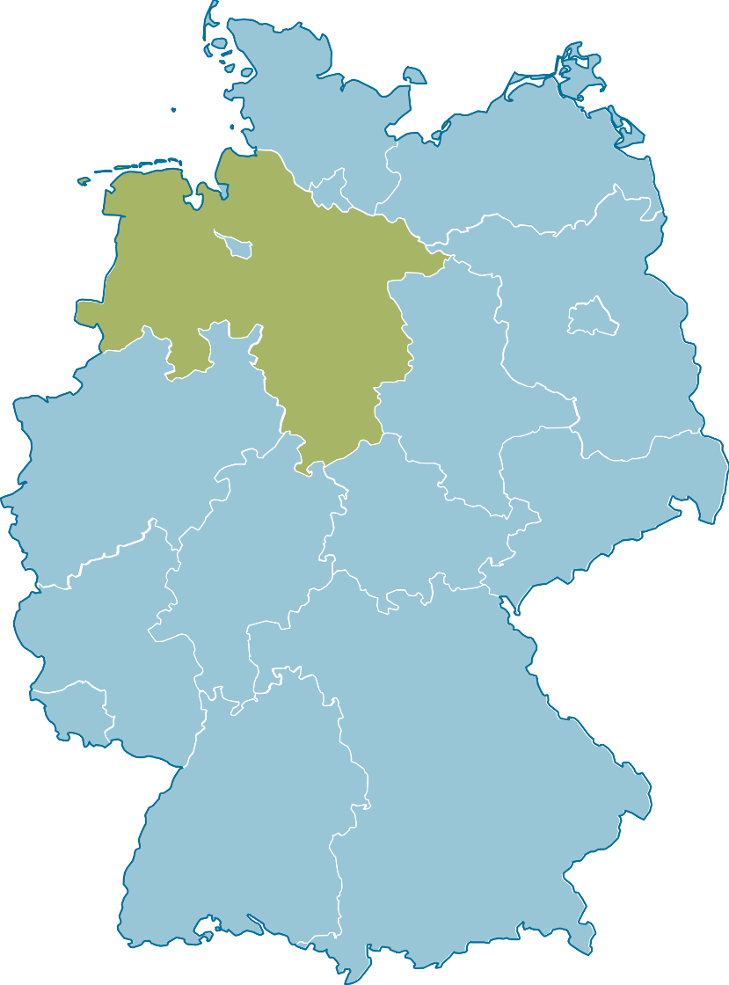


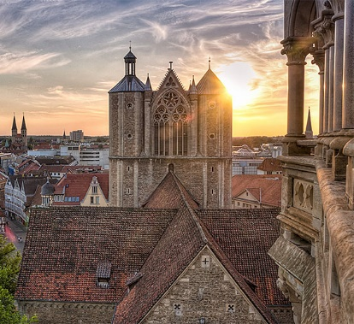
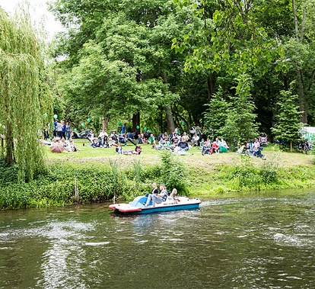
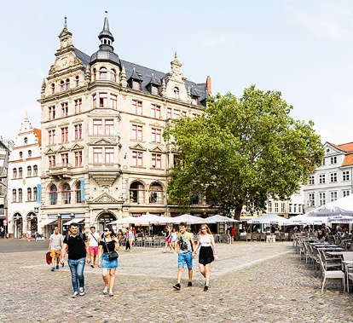
The City of Braunschweig
  population of 250,000
  second largest city in Lower Saxony
  first mentioned in 1031, important cultural and political centre since the middle ages, member of the Hanseatic League
  central position in the heart of Germany
  ranks 4th among all major German cities in terms of
  quality of life
Berlin
Braunschweig

Slide 14




Let’s get in touch!
Prof. Dr. First Name Last Name
Institute for XYZ
f.lastname@tu-braunschweig.de
www.tu-braunschweig.de/xyz
Follow us on Social Media:
Notes:
14

