Slide 1



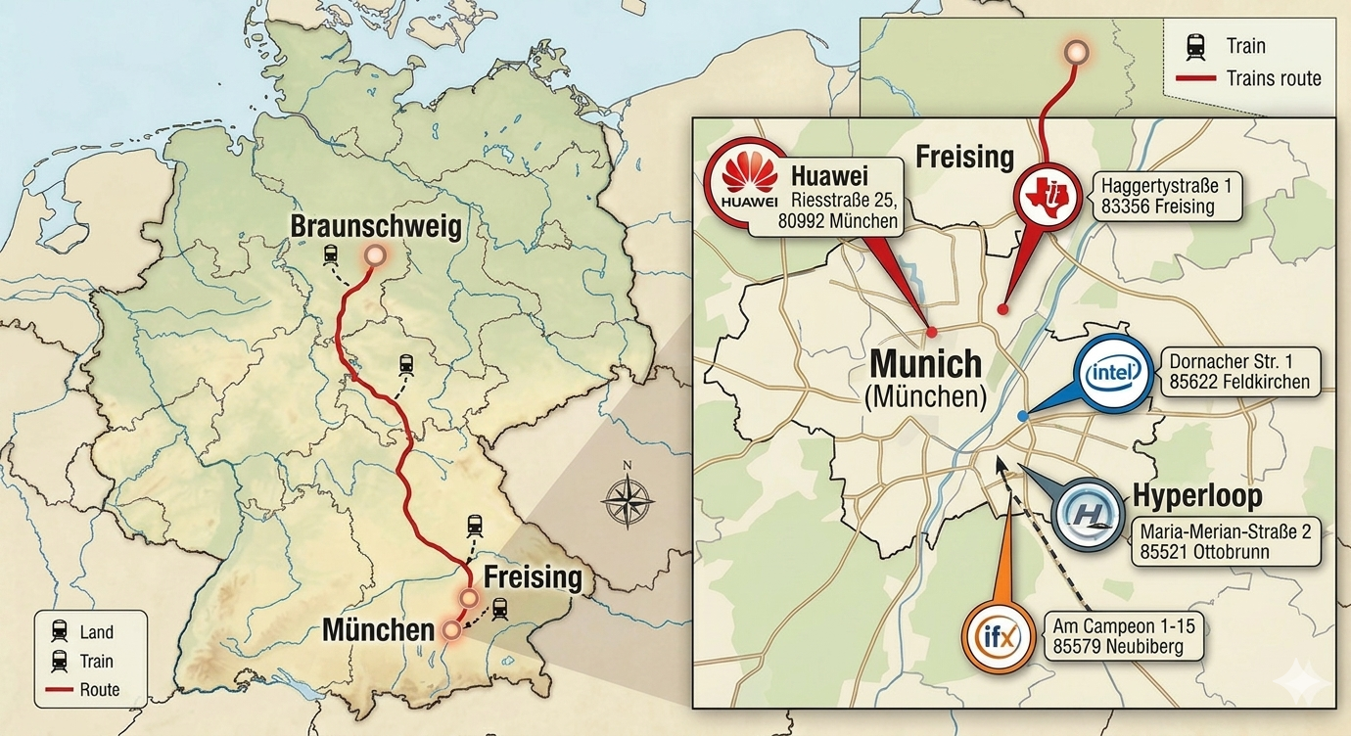
Summer Excursion to Munich May 26 – May 28

Slide 2
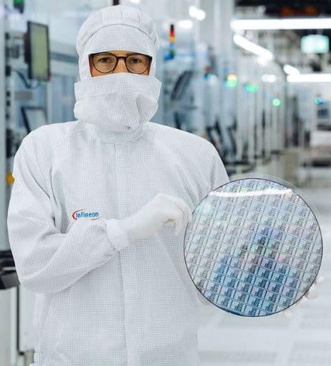


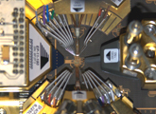
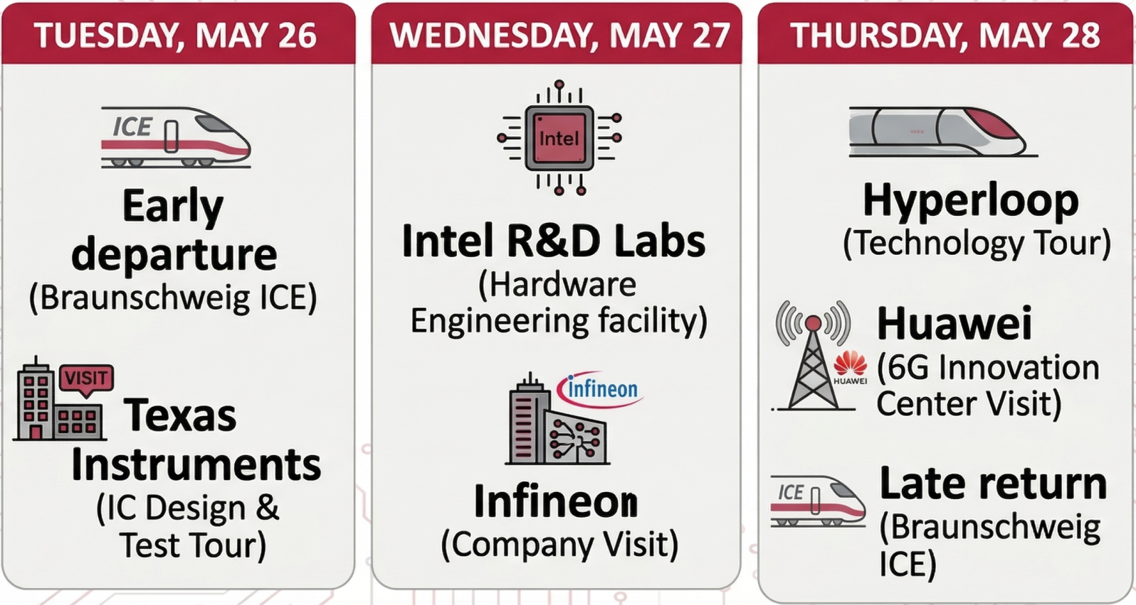



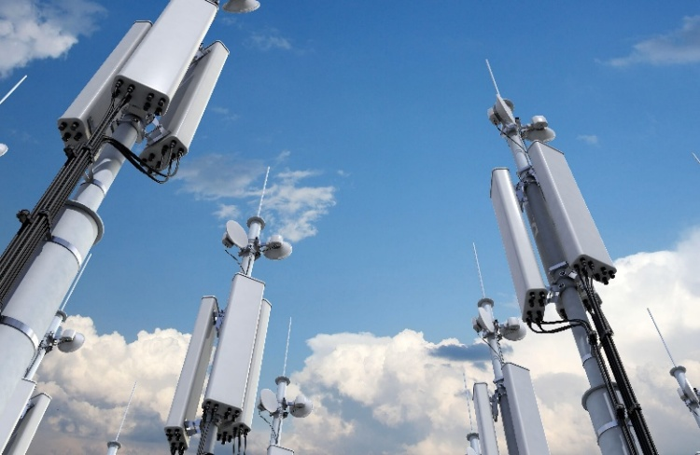
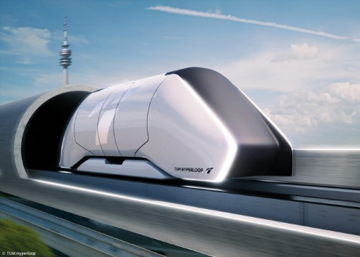
Summer Excursion to Munich May 26 – May 28
Limited Capacity: Only 25 spots available!
Partially funded by SQM: Train tickets (ICE), hotel accommodation, partial catering covered! (bring 60€)
Target Audience: Students interested in RF/analog IC design, network technologies, and hardware engineering
✘
Contacts: Paul Nowitzki, p.nowitzki@tu-braunschweig.de
Jan Stoebe, jan.stoebe@tu-braunschweig.de

Slide 3
Summer Excursion to Munich May 26 – May 28
How to register?
27.04.2026 at 11:00
IfN, Schleinitzstr. 22, Room 232B
Bring 60€ in cash
First come, first served

